Slide 1
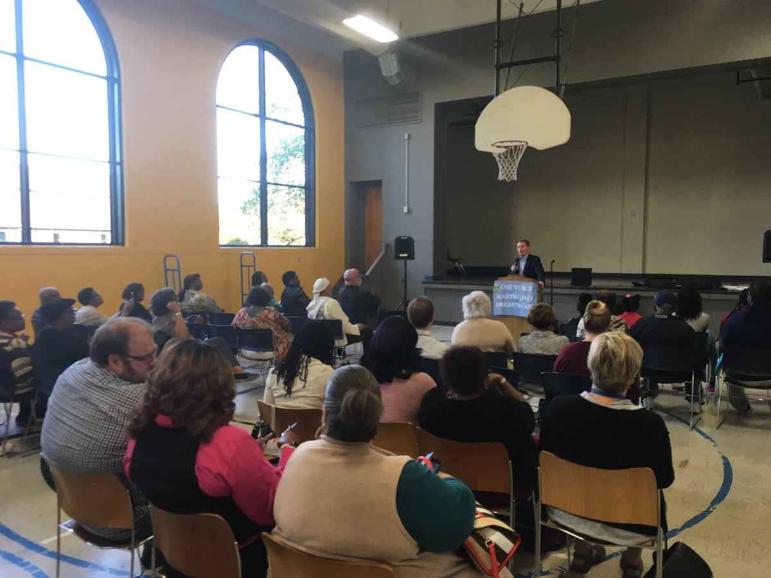
WELCOME
Advancing Equity through Collective Impact
Developing a Collective Impact Approach for Inclusive Community Development
Understanding the collaborative network—Assessing strengths and capacity to carry out the work
Resources to strengthen a collaborative model
Notes:
Developing a Collective Impact Approach for Inclusive Community Development
Understanding of a collaboration network- Assessing strengths and capacity to carry out the work
Resources available to strengthen a collaboration
Overview of Collective Impact- Tysha – 5 minutes
Goals of this presentation
General overview to provide context
Specially our areas— What does this mean_ Gina—10 minutes
About us
Area that is served (map)
Area information — the need and the opportunity
Community Action structure
Needs the of area— QOL
Identification of needs of the area
QoL strategies
MB7- Gina Lewis Alexander— transformation- community- 10 minutes
Outcomes 7 areas
Timeline of action
Anatomy of Collective Impact- Tysha -5 minutes
Assessing community strengths
Data collection importance— Rhiannon- 10 minutes
Social return on investment
Shared outcomes
Mutually enforcing activities—Gina & Gina—5 minutes
MOVE team & One Voice
Resources and Support—Tysha- 5 minute
Handout review
Q&A- 25 minutes

Slide 2
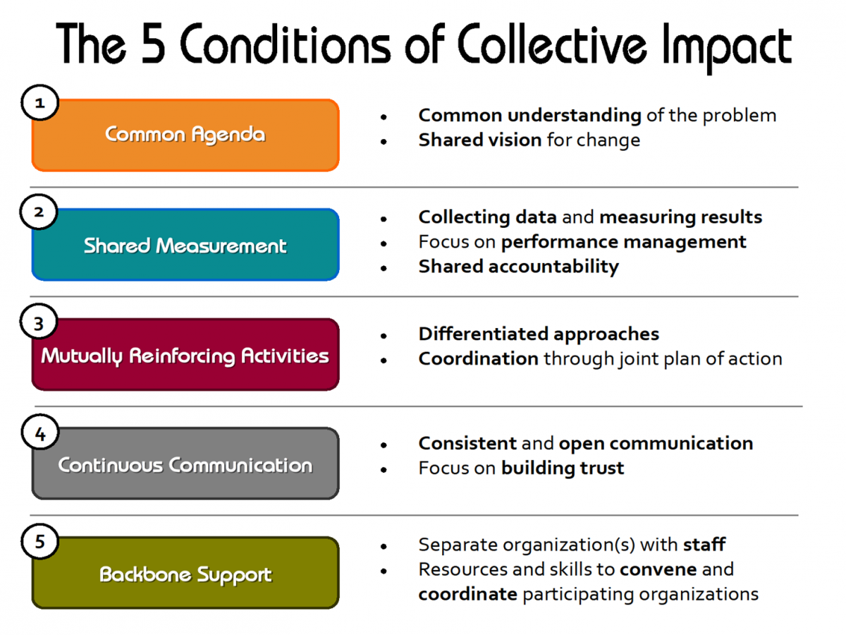
Notes:
OneVoice with MOVE as its action team formed a Collective Impact Group to advance 6 neighborhood projects of the QoL.

Slide 3
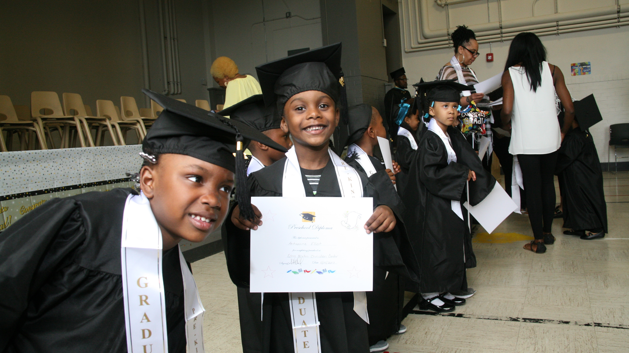
Advancing
Martindale-Brightwood
People + Place Approach
Notes:
Takeaways:
Overview of Martindale-Brightwood area community decision making structure and activity
Understand our Collective Impact Model to address issues as well as improve the area based on community-led projects
Consider investing in our Collective Impact model

Slide 4
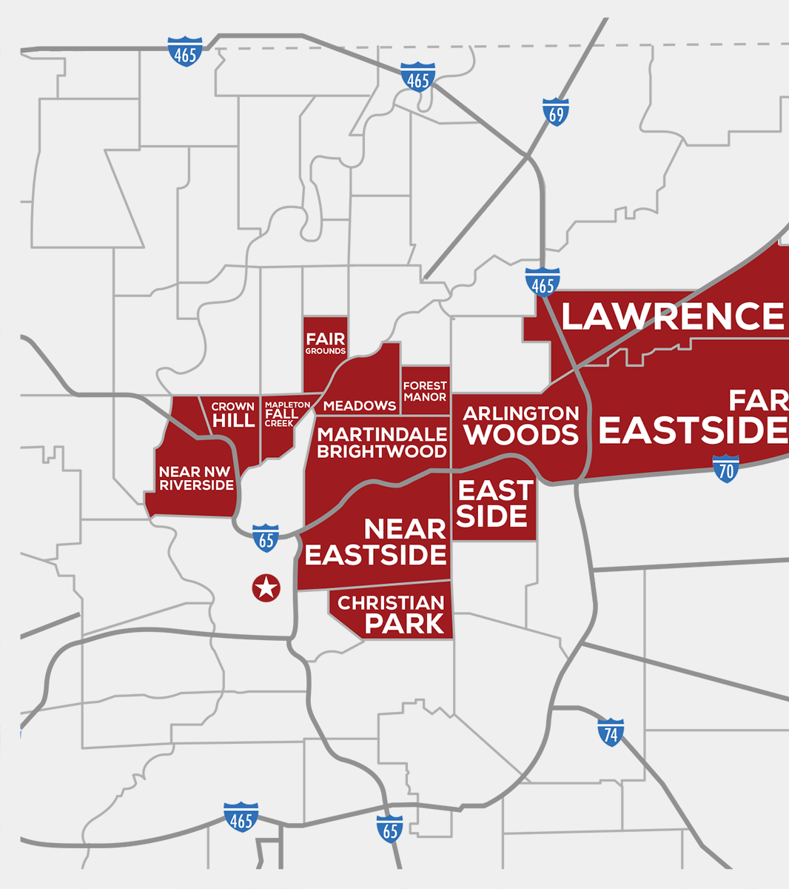
Martindale-Brightwood Community
&
Near Northeastside Indianapolis Area

Slide 5
ABOUT US
Martindale-Brigtwood is a community of 10,000+ on the near-northeastside with active, engaged, vocal residents, businesses, and agencies working together to provide community-based solutions that result in thriving people and places.
Notes:
Many people have worked hard and investments have been made in multiple programs in the Martindale-Brightwood area over time. While progress has been made in some areas, the neighborhood has not transformed in the way that we need it to. A concerted effort, led by a collective team members who are focused on immediate and long-range projects with outcomes in key areas may be the answer.

Slide 6
Community Action Structure
OneVoice
MOVE
Backbone Agencies
OneVoice is the community congress of Martindale-Brightwood represented by 50% residents and 50% community stakeholders. It is responsible for communicating the SWOT of the area through the Quality of Life Plan; mobilizing stakeholders to take action; and nurturing resident leadership.
MOVE is the “action team” of OneVoice with the responsibility of creating strategies that result in fulfilling the goals of the Quality of Life Plan and developing community leadership.
Backbone agencies are responsible for implementation and evaluation of specific, time-bound community directives to advance QoL goals; provide strategic direction; and connect partners to resources in order to meet community objectives.
Notes:
With the help of Annie E. Casey, CICF and others, MB has a working community action structure with an active community congress, action team, and backbone agencies. The responsibility of this combined team is to identify and monitor community trends and needs; develop strategic and action plans; and execute and evaluate those plans based on resources and connections.

Slide 7
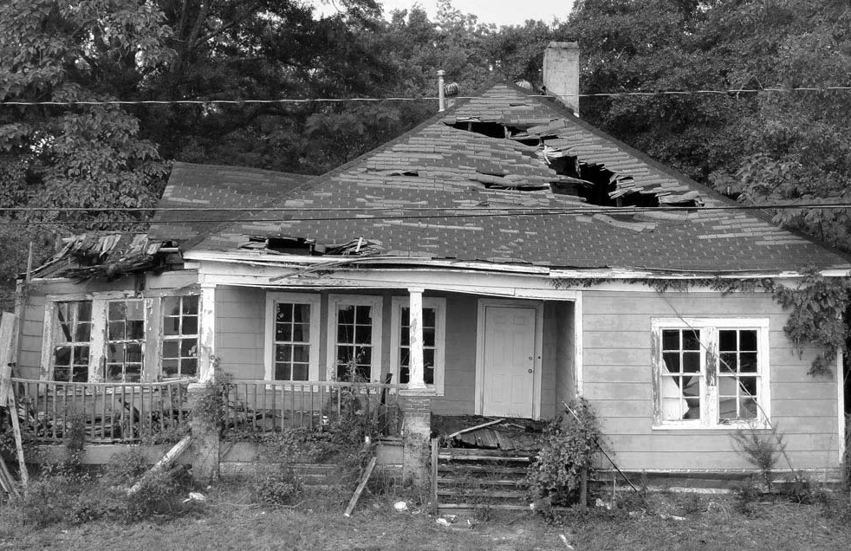
COMMUNITY
ANALYSIS
Weakness
Low-level Educational achievement
Low level of affordable housing stock
Low economic mobility and opportunity
High unemployment
Perception of disconnection and disinvestment
High crime rates
Cultural and environmental abandonment
Notes:
As part of that responsibility, the Martindale-Brightwood team has conducted community scans to identify the needs of the area which are statistically illustrated by the vast disparities in education, employment, health, food access, housing and more.

Slide 8
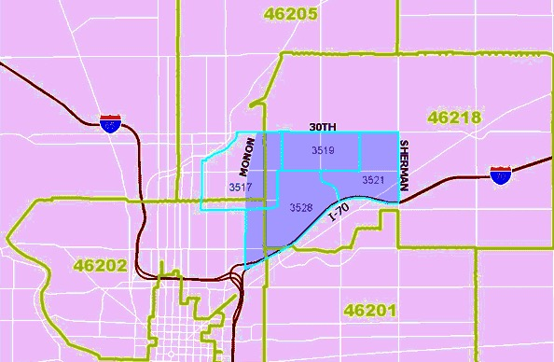
COMMUNITY
ANALYSIS
Threats
Outside investors leveraging economic development opportunity, yet disconnect to the community and community vision
Leadership relocating
Systems of silo-ed community development activity
System of silo-ed investments
Delay in coordinated action
Notes:
We know the statistics and are working to address. However, we are also keenly aware of the compounding negative impact of siloed work and development that is not connected to community goals.
Therefore, to address these challenges we choose to align and uplift our community assets. We seek to develop our assets and strategically place them within the context of a common agenda so we can implement and scale plans that are transformative.

Slide 9
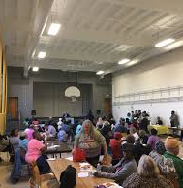
COMMUNITY
ANALYSIS
Strength
Investments in Martindale-Brightwood community development from CICF, Annie E. Casey, local foundations, businesses, and others
Development of community action infrastructure
Asset-based framework
Collective Impact Model
Immediate Action Plan focused on the next 4 years
Development of 16th Street Corridor (south): Monon Trail (west); housing plans (east); increased commercial development (north)
Notes:
Economic development projects along 16th Street and Mass Ave to the south; and Housing and commercial corridor projects to the west have intensified attention on the area. As this has taken place, MB residents, agencies, businesses, and schools have galvanized to leverage these developments, while focusing on the needs and vision of the people living in the area so everyone has the opportunity to contribute to the development of a thriving community.

Slide 10
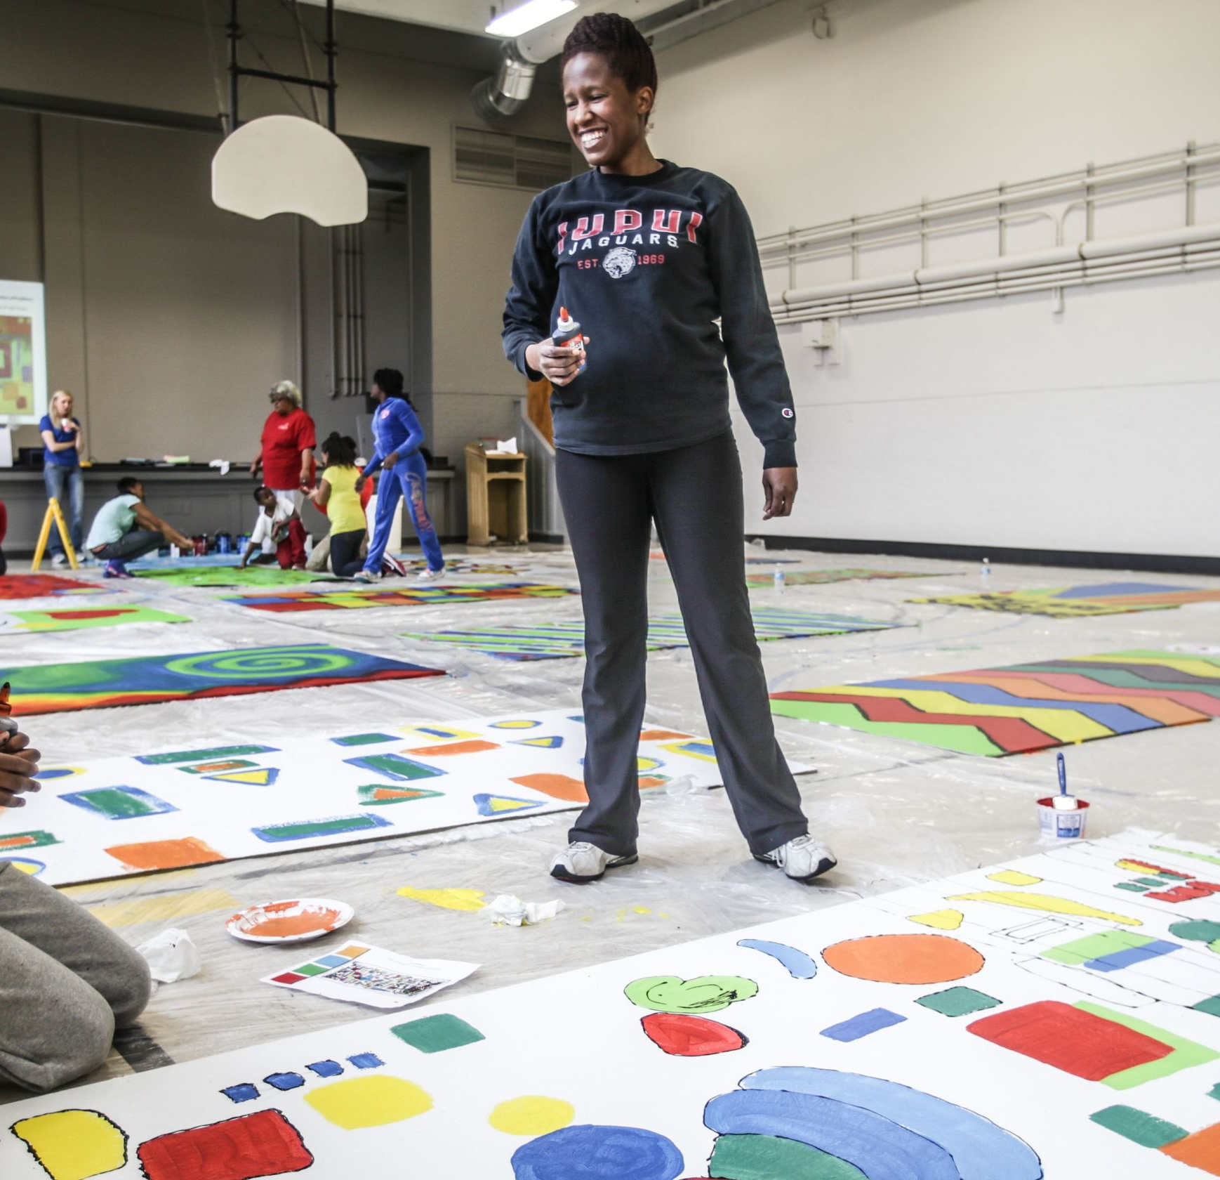
COMMUNITY
ANALYSIS
Opportunity
Martindale--Brightwood Collective Impact Team
Focus on Community Leadership Development
Focus on 6 projects for advancing the area through 2022
Other Funder Support in a place-based strategy
Notes:
There is a promising future for this area because the plan and people are in place to make change happen.
At this time, nearly 100 agencies and businesses, residents, and supporter are working together to leverage the power of engaged people and surrounding development to improve the MB area with a new action plan.

Slide 11
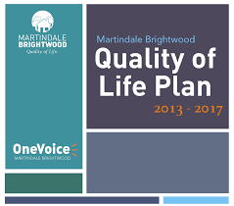
MBCI Project Focus Areas People + Place Goals
Education
01
04
Built Environment
Children meet growth and development milestones
Children kindergarten ready
School-age children are college and career ready
Enhance resident access to arts, recreation and entertainment
Increase the cleanliness and beautification of the area through placemaking
Economic Mobility
02
05
Food Access
Adults obtain and maintain employment
Increase in community businesses
Increase in entrepreneurship
Increase in food security
Increase in community produced goods
06
Community Leadership & Connectivity
Housing Stability
03
Connect neighbors with one another through events, information, community news, and trainings
Develop community fellows program to cultivate MB leadership
More affordable housing options
Notes:
CI project areas cover:
Education
Economic Opportunity
Built Environment
Food Access
Community Leadership and Connectivity

Slide 12
MB7: Martindale-Brightwood
Collective Impact Strategies 2018-2022
MB Education Zone
& MB housing
Community Solutions &
Entrepreneurship Center
Community Voice
News Network
50+ Partners
17 MB Partners
16 Partners
6 MB partners
6 Partners
5 MB Partners
25th Street Corridor
PACE Recovery Resource Center
Leadership & Legacy Campus
MB Food Resource Network
23 Partners
14 MB partners
10 development partners
4 MB Program Partners
11 Partners
6 MB Partners
Notes:
Building on this work, The Martindale-Brightwood Community Collective has selected 6 projects to be implemented during 2018 and continue through 2022. These projects which have received endorsements from the Mayor, local foundations, major businesses, and community agencies. Each have their own plan and budget.
25th Street Corridor consists of place-making and identity projects over a four mile stretch from the Monon Trail to Sherman Avenue. Work started in 2018 and is to be completed in 2022. Structural improvements include placemaking, signage, beautification, public art, streetscape improvements, business façade improvements, open air marketplace, improved usage of lots and more.
Leadership and Legacy Campus includes a new High School, a 2 acre urban farm, recreational facilities, Senior Center, Day Care, After School Program and more. Phase I was completed in 2018. Phase 2 includes KIPP Legacy High School, a two acre urban farm—the Henry Blair Farm, and the Community Solutions & Entrepreneurship Center.
Community Solutions and Entrepreneurship Center will provide a space community development and leadership training. The Entrepreneurship center will provide education and training for residents to startup and scale-up businesses. A micro-enterprise coach has been hired using public and private funding for a 3 year pilot.
The project will launch in 2019 at the LLC with a permanent space built out in later years.
.
Martindale-Brightwood Education Zone featuring affordable housing. Approximately 50 new single family homes and new amenities. The housing project starts in 2018 and will be completed in 2022. MB gain site control of 10 lots in 2018.
Martindale-Brightwood Food Resource Network will include several inner-city growing centers, including the 2 acre Henry Blair Farm to help provide fresh produce on a neighborhood level. Expansion of the project will launch in 2019.
Community Voice News including a monthly publication with updates and community calendar of 4 to 8 pages. Four times a year, there will be extra features in a 12-page publication. Project will expand in 2019.
These projects will have a lasting impact and help facilitate transformative change for Martindale-Brightwood. The Community services inherent in the projects will help us reach our people and place goals.

Slide 13
Timeline for Execution of Dev. Projects
Monon16 and 22nd Street Development
PACE Addictions and Counseling Center
Beautification- trees, flowers, public art
Farmer and Artisan Market @ Martindale Oasis Marketplace (open air market)
Entrepreneurship & Community Solutions Center
Martindale-Brightwood Education Zone Launch
Community Voice News Network Launch
25th Street Corridor activities launched
MB Food Resource Network
Henry Blair Farm Launch
Building Façade improvements
New Development
Henry Blair Innovation Forum
Beautification- trees, flowers, public art
2018
2020
2019
2021
Sidewalk Redevelopment and Street Paving
Leadership and Legacy Campus reveal
Community clean ups
Farmer and Artisan Markets
25th Street Corridor plan finalized
4 Generations Community Gardens
Building Façade improvements
New Brightwood Library Opening
MBEZ housing housing Phase I development completed
Henry Blair Innovation Project Forum
Beautification- trees, flowers, public art
Notes:
The timeline for the execution of the Projects included in this plan spans from 2018 through 2022. The projects include facilities development, environmental enhancements and other visual related improvements
In tandem with the Projects being implemented, programs and events are planned focusing on the people of Martindale-Brightwood and bringing the community together.

Slide 14
Timeline for Execution of Programs & Events
Street Art Showcase
Jazz Under the Stars
Henry Blair Innovations Camps
Beautification- trees, flowers, public art
Modular Art Showcase
Station Street Live
Opera Education
Henry Blair Innovations Camps
Jazz Under the Stars
Farmer and Artisan Market @ Martindale Oasis Marketplace
2018
2020
2019
2021
Douglass Park Family event
Harvest Family Fun Festival
Station Street Festival
Farmer and Artisan Markets
Movies in the Park
Opera Education
Henry Blair Innovations Camps
Beautification- trees, flowers, public art
Modular Art Showcase
Peach Fest

Slide 15
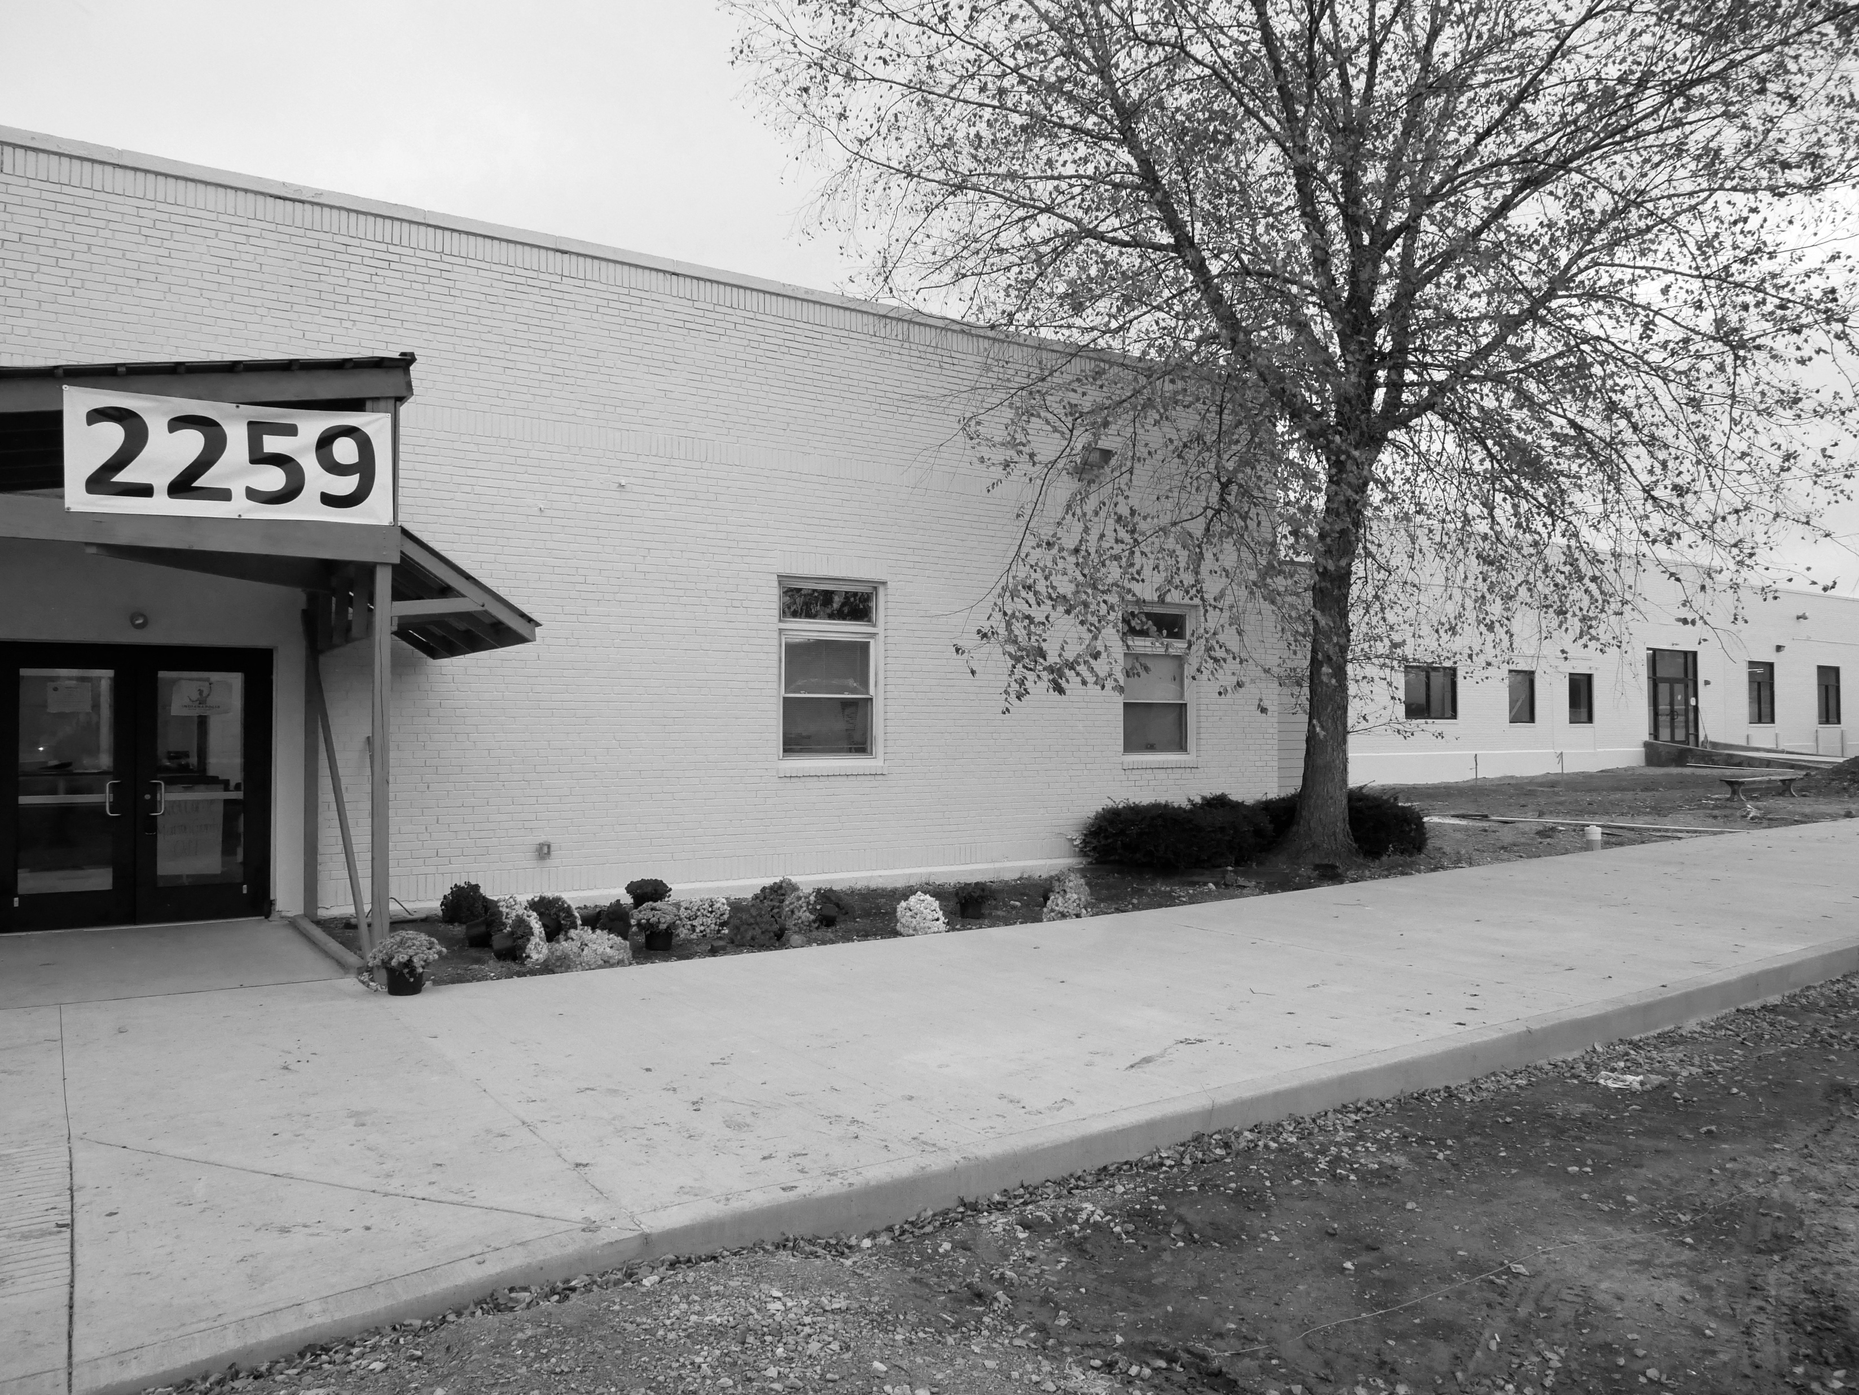
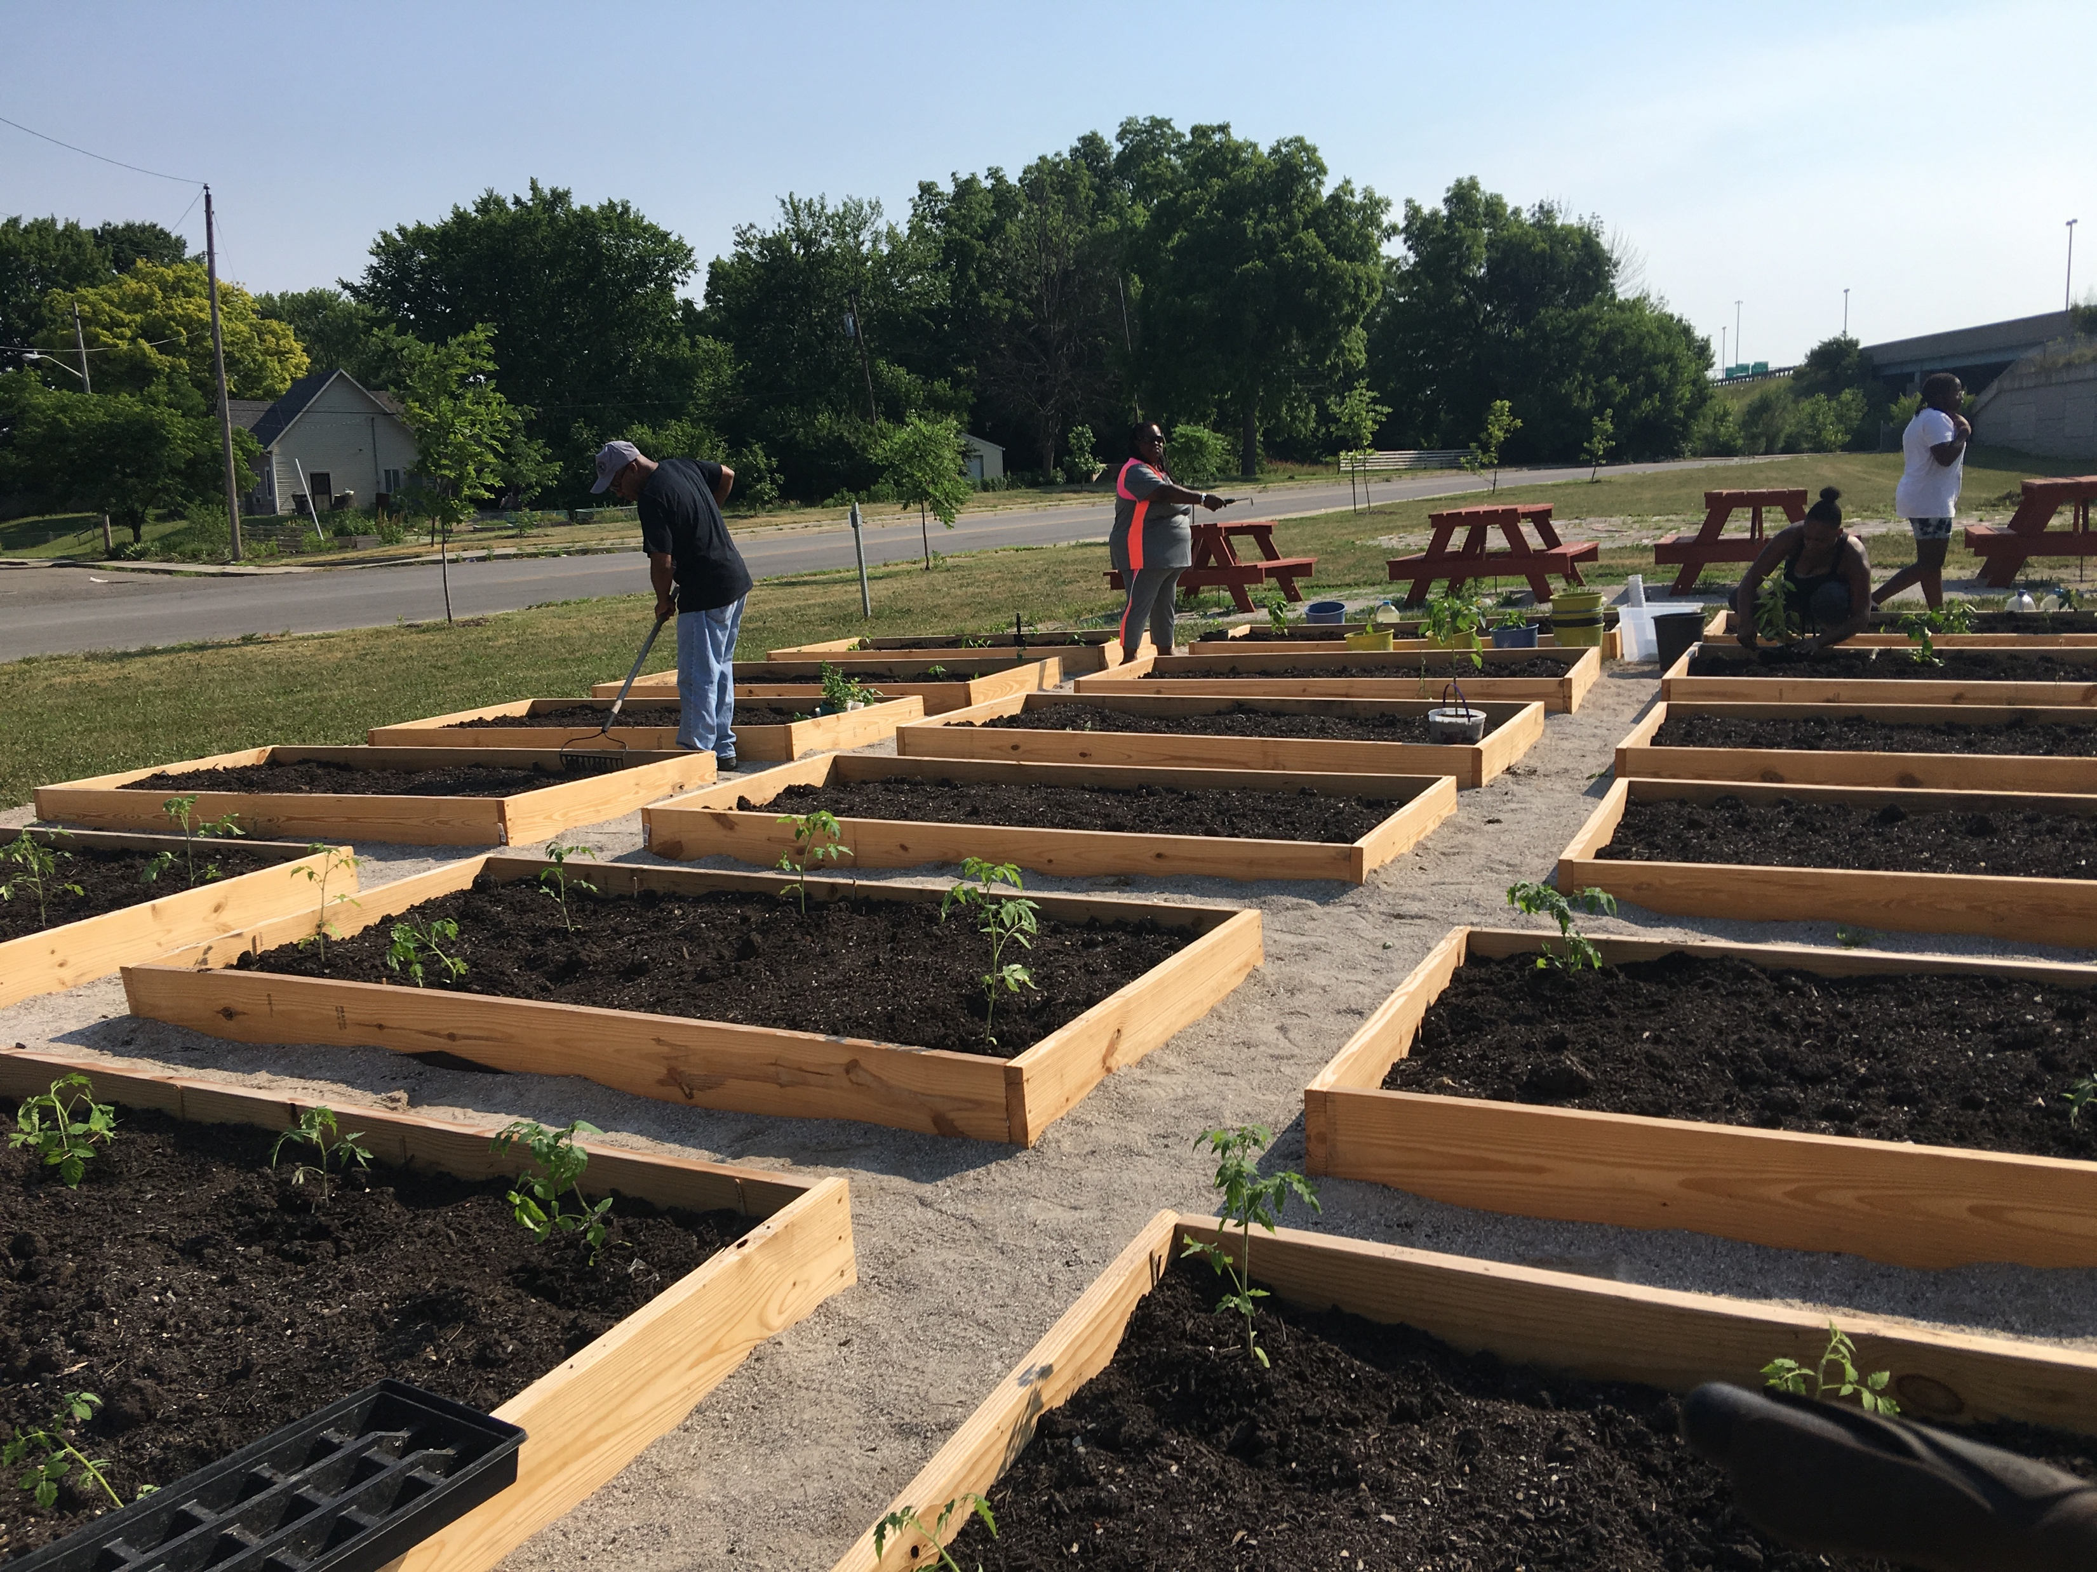
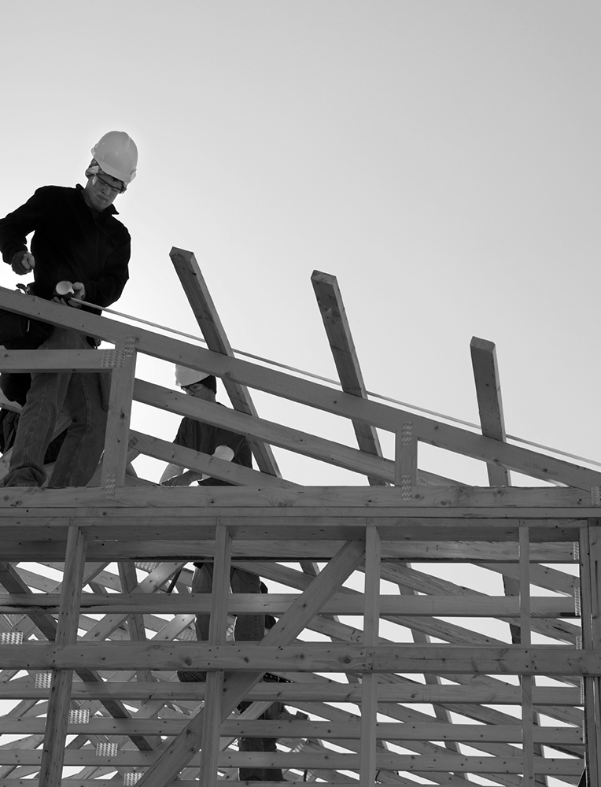
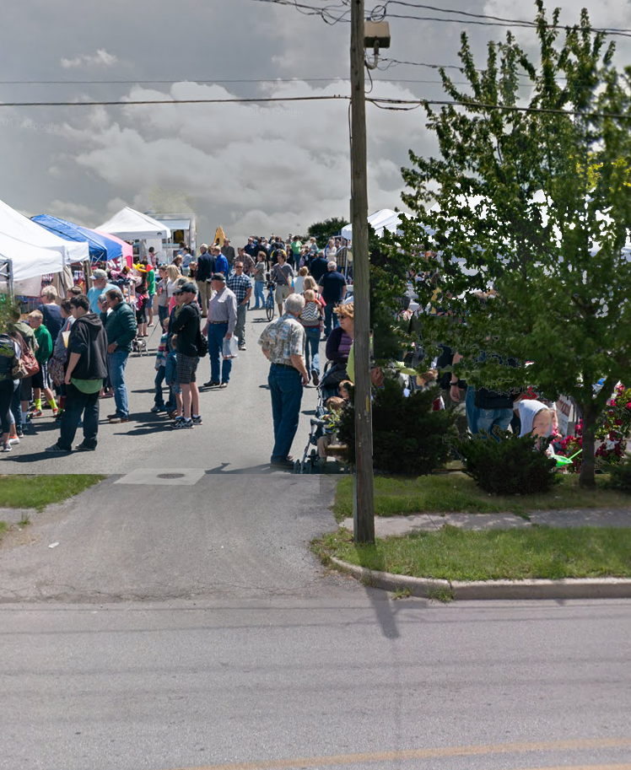
INITIAL MBCI
RESULTS
Developed a 25th St. Corridor Plan with Ball State University (Built Environment)
Completed a $3 million renovation of the former Jireh Sports site and launched phase 2 (Built environment; Education; Workforce Development; Youth)
Developed a scholar housing plan to be implemented in 2019 (Built environment/Housing Stability)
Launched the generations gardens program which has grown to become the Martindale-Brightwood Food Resource Network (Built environment; food access; health promotion)
Launched consumer marketplace at 25th and Andrew Brown in partnership with Oasis CDC, EMCC, and Brandywine Creek Farms (Built environment; food access; health promotion)
Advocated and gained investment in community park —Douglass Park (Youth; Built environment)
Launched the PACE Recovery Resource Center — (Financial Stability; Workforce Development; Crime & Safety)
Notes:
Developed a 25th St. Corridor Plan with Ball State University
Completed a $3 million renovation of the former Jireh Sports site
Developed a scholar housing plan to be implemented in 2019
Launched the generations gardens program (Star Media grant) which has grown to become the Martindale-Brightwood Food Resource Network
Brandywine Creek Farms mobile market

Slide 16
Notes:
OneVoice with MOVE as its action team formed a Collective Impact Group to advance 6 neighborhood projects of the QoL.

Slide 17
Data Collection and Accountability
Defining the problem
Agreeing on lead agents
Agreeing on shared collection methods and metrics across agencies
Valuing our impact (Social Return on Investment example)
Reporting out
Shared accountability through community of practice
Shared accountability through ongoing community engagement

Slide 18
Examples of Mutually Reinforcing Activities
Center for Working Families groups
OneVoice and MOVE action teams
Youth collaborative roundtables

Slide 19
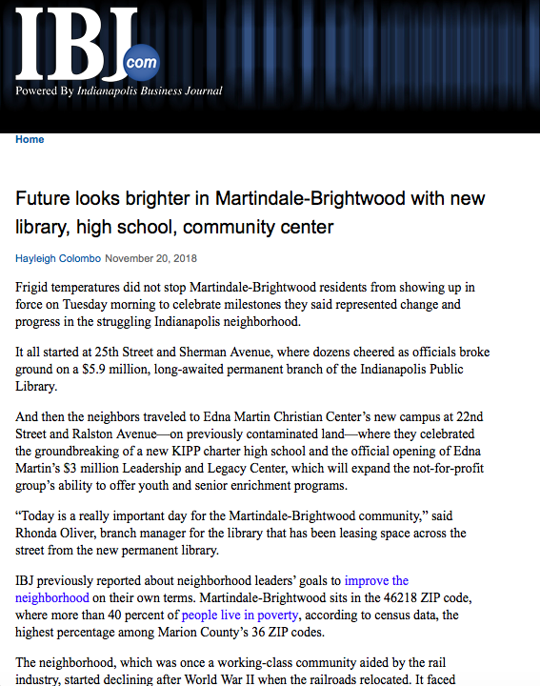
Notes:
There is a lot of momentum and excitement about the future possibilities for Martindale Brightwood.
The community is united and the time is now.

