Slide 1
Finding Solutions to Adaptive and Technical Challenges

Slide 2
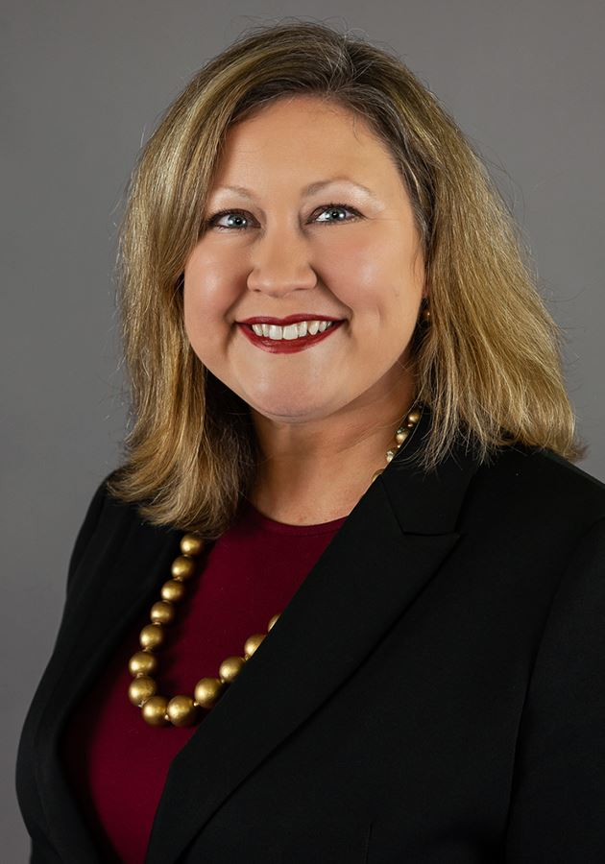
Welcome
Jessica Love, Executive Director
Prosperity Indiana

Slide 3
Tech Tips _____________
All lines are muted.
Feel free to ask questions by typing your question in the chat box.
If you lose Internet connectivity, reconnect using the link emailed to you
The presentation and recording will be available on Prosperity Indiana’s COVID-19 Hub

Slide 4
Our Network
www.prosperityindiana.org

Slide 5
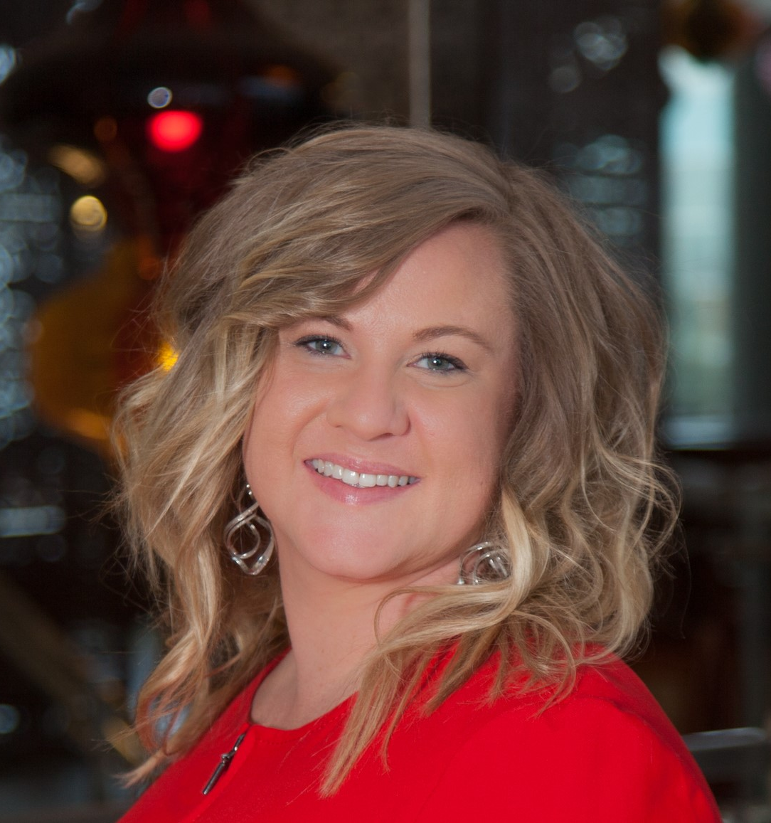
Our Sponsor
Pamela Torzewski | First Financial Bank
Pamela.Torzewski@bankatfirst.com

Slide 6
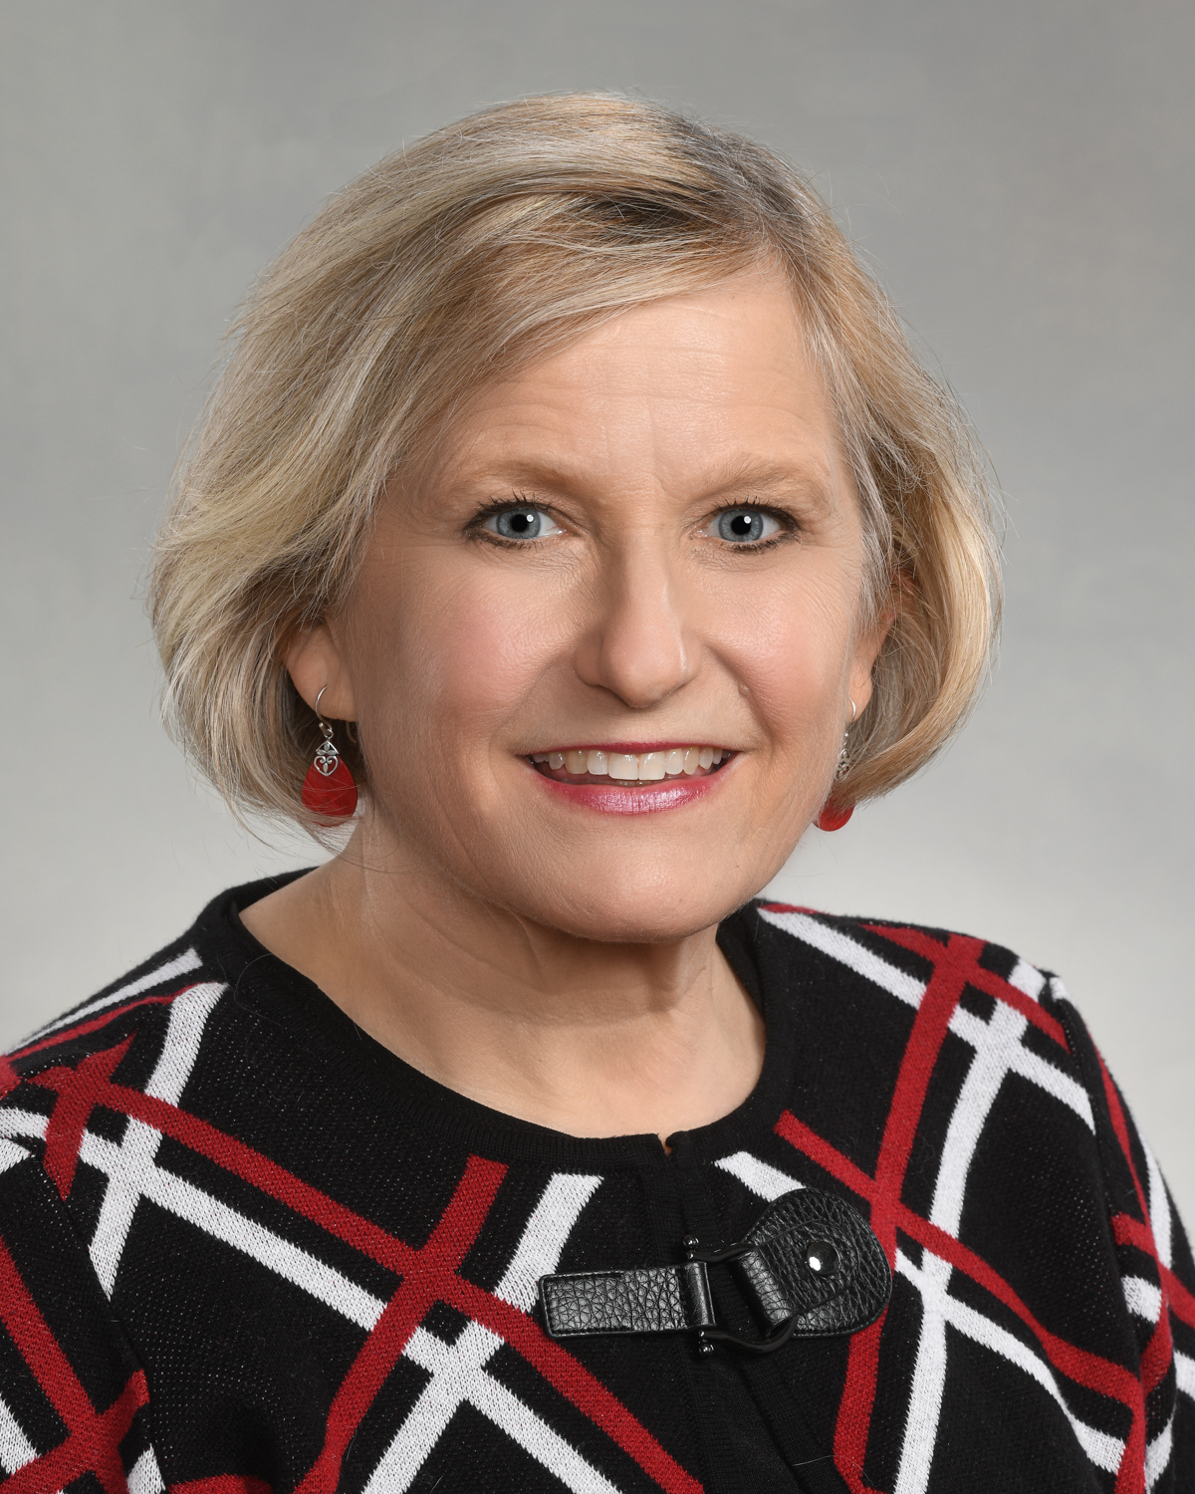
Presenter
Marie Beason, Capacity Building Director
Prosperity Indiana

Slide 7
Changing4Good
Matching the Solution to the Challenge: Adaptive & Technical Solutions for Change

Slide 8
Policy
Philanthropy
Programs
Change

Slide 9
Objectives ______________
Understand difference between technical and adaptive challenges.
Apply adaptive and technical solutions to organizational and programmatic challenges.

Slide 10
Learning new software, working from home, a difficult boss, becoming a parent ...
One Challenge
You Have Faced ______________
Please share via
chat feature

Slide 11
The What ______________
Technical
vs.
Adaptive
Change
The “What”

Slide 12
Adaptive vs. Technical Change

Slide 13
Technical Change
Requires a “fix,” expert, or an authority
Improve quality…
Decrease the time it takes to…
Reduce costs…
The Change Iceberg
Adaptive Change
Requires individual or culture change to address:
Behaviors
Attitudes
Assumptions
Values
Past experiences
Habits
Perceptions
Beliefs
Power/Politics
Cultural norms

Slide 14
Technical or Adaptive Solution?
Technical Change
Requires a “fix,” expert, or an authority
Help identify if the following is a technical change (above the water line), an adaptive change (below the water line), or both (near the water line).
Switch service providers to improve internet stability
Adaptive Change
Requires individual or culture change to address:
Behaviors
Attitudes
Assumptions
Values
Past experiences
Habits
Perceptions
Beliefs
Power/Politics
Cultural norms
Change out of your PJs for a Zoom staff meetings
Add additional time to
project planning time banks
Donate money to a
racial equity cause
Use Go Fund Me for annual campaign
Convene clients to speak about how COVID impacted their financial plans

Slide 15
Technical or Adaptive Solutions
Switch service providers to improve internet stability
Technical Change
Requires a “fix,” expert, or an authority
Donate money to a
racial equity cause
Add additional time to
project management time banks
Change out of your PJs for a Zoom staff meetings
Adaptive Change
Requires individual or culture change to address:
Behaviors
Attitudes
Assumptions
Values
Past experiences
Habits
Perceptions
Beliefs
Power/Politics
Cultural norms
Use Go Fund Me for annual campaign
Convene clients to speak about how COVID impacted their financial plans

Slide 16
The “So What” or Why ______________
The “So What”
Costly
Time-Consuming
Frustrating
Less-Effective

Slide 17
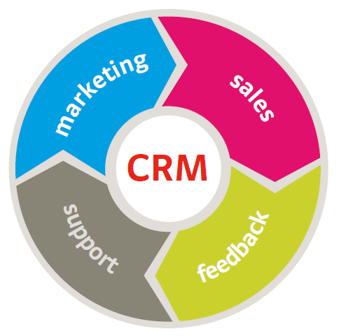
Technical or Adaptive Solutions for Internal Change

Slide 18
Technical or Adaptive Solutions for External Change
Image by Free-Photos from Pixabay

Slide 19
The “What Now” or How ______________
The “What Now”
The
“What Now?”
The biggest mistake a leader or team can make is trying to solve adaptive challenges with only technical solutions!
The “What”

Slide 20
Look Outward ______________
Ask, “What is the Nature of the Work Before Us”
Get on the Balcony
Identify Shifts
Image by David Mark from Pixabay

Slide 21
Look Around ______________
Conduct a Landscape Scan
ID Best Practices
Give the work to the People
Image by Vinson Tan from Pixabay

Slide 22
Look Inward ______________
Challenge Orthodoxies
ID your, your values, beliefs…
Image by dietercn from Pixabay

Slide 23
Look Forward ______________
Decide Path
Generate Ideas
Prototype
Image by Lorisha Koshknna from Pixabay

Slide 24
Questions?
Please use chat feature

Slide 25
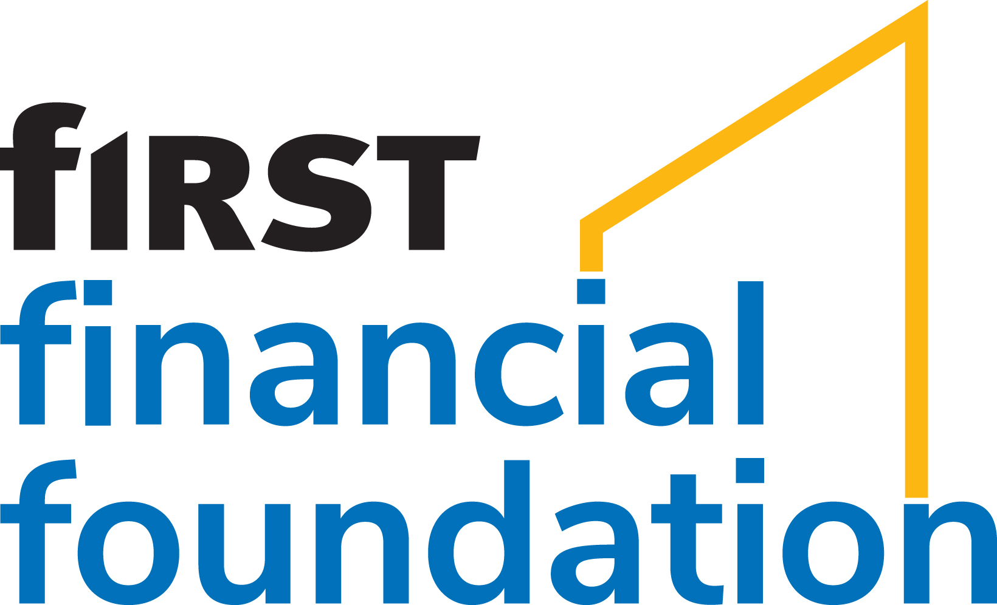

Slide 26
Join Us
April 26
Planning for Uncertainty: COVID’s Impact on
Project Planning & Project Management
May 10
Building Racial Equity:
Pursing Adaptive and Technical Solutions
May 24
We Will Meet Again: COVID’s Impact on Building Teams, Engaging Boards, and Managing Volunteers
June 7
Post-COVID Solutions for Fund Development
June 21
Financial Resiliency: Technical and Adaptive Solutions for Family Asset Building Strategies

Slide 27
Join the Network!
If you are interested reaping the benefits of PI membership, please contact PI’s Engagement Director :
Rita O'Donohue rodonohue@prosperityindiana.org 317.222.1221 x405

