Slide 1
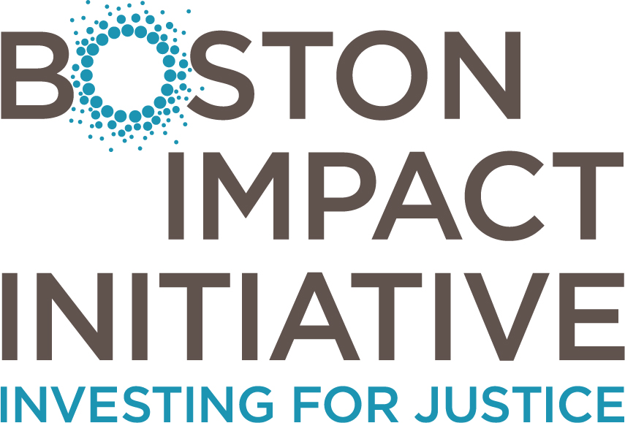
Investing to Close the Racial Wealth Divide
Prosperity Indiana
January 30, 2019

Slide 2
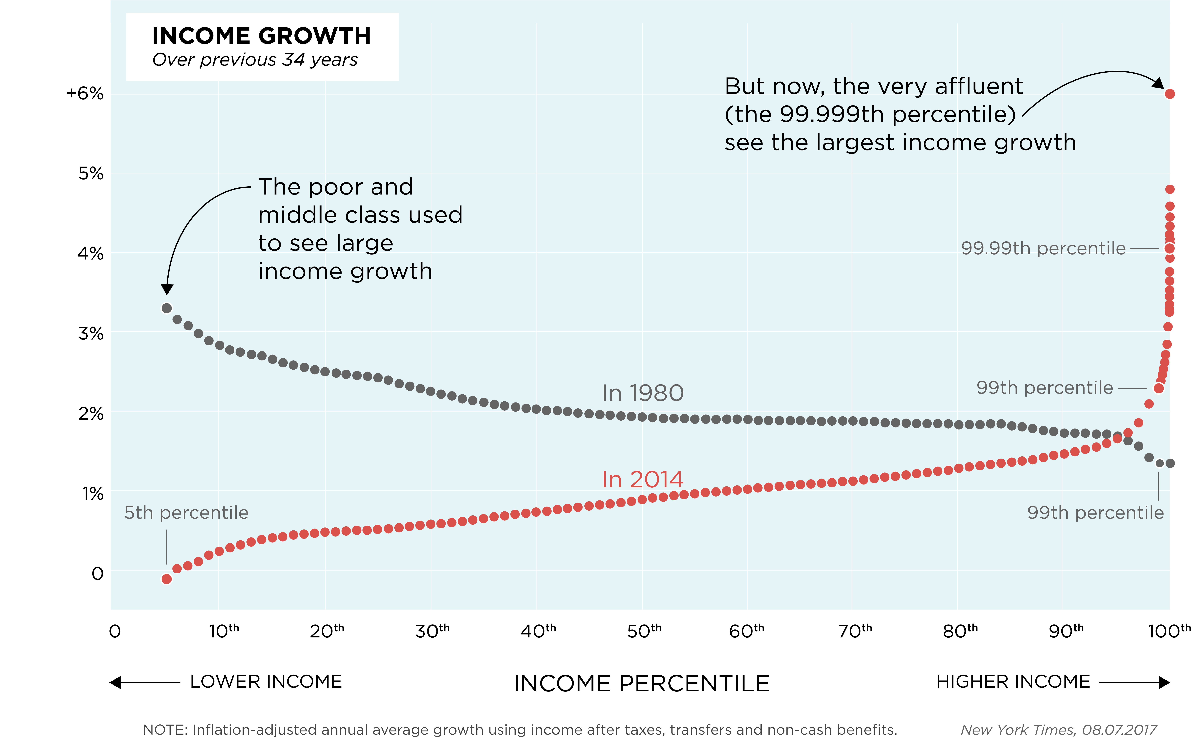
NATIONALLY, INEQUALITY IS ACCELERATING
New York Times, 08.07.2017
1

Slide 3
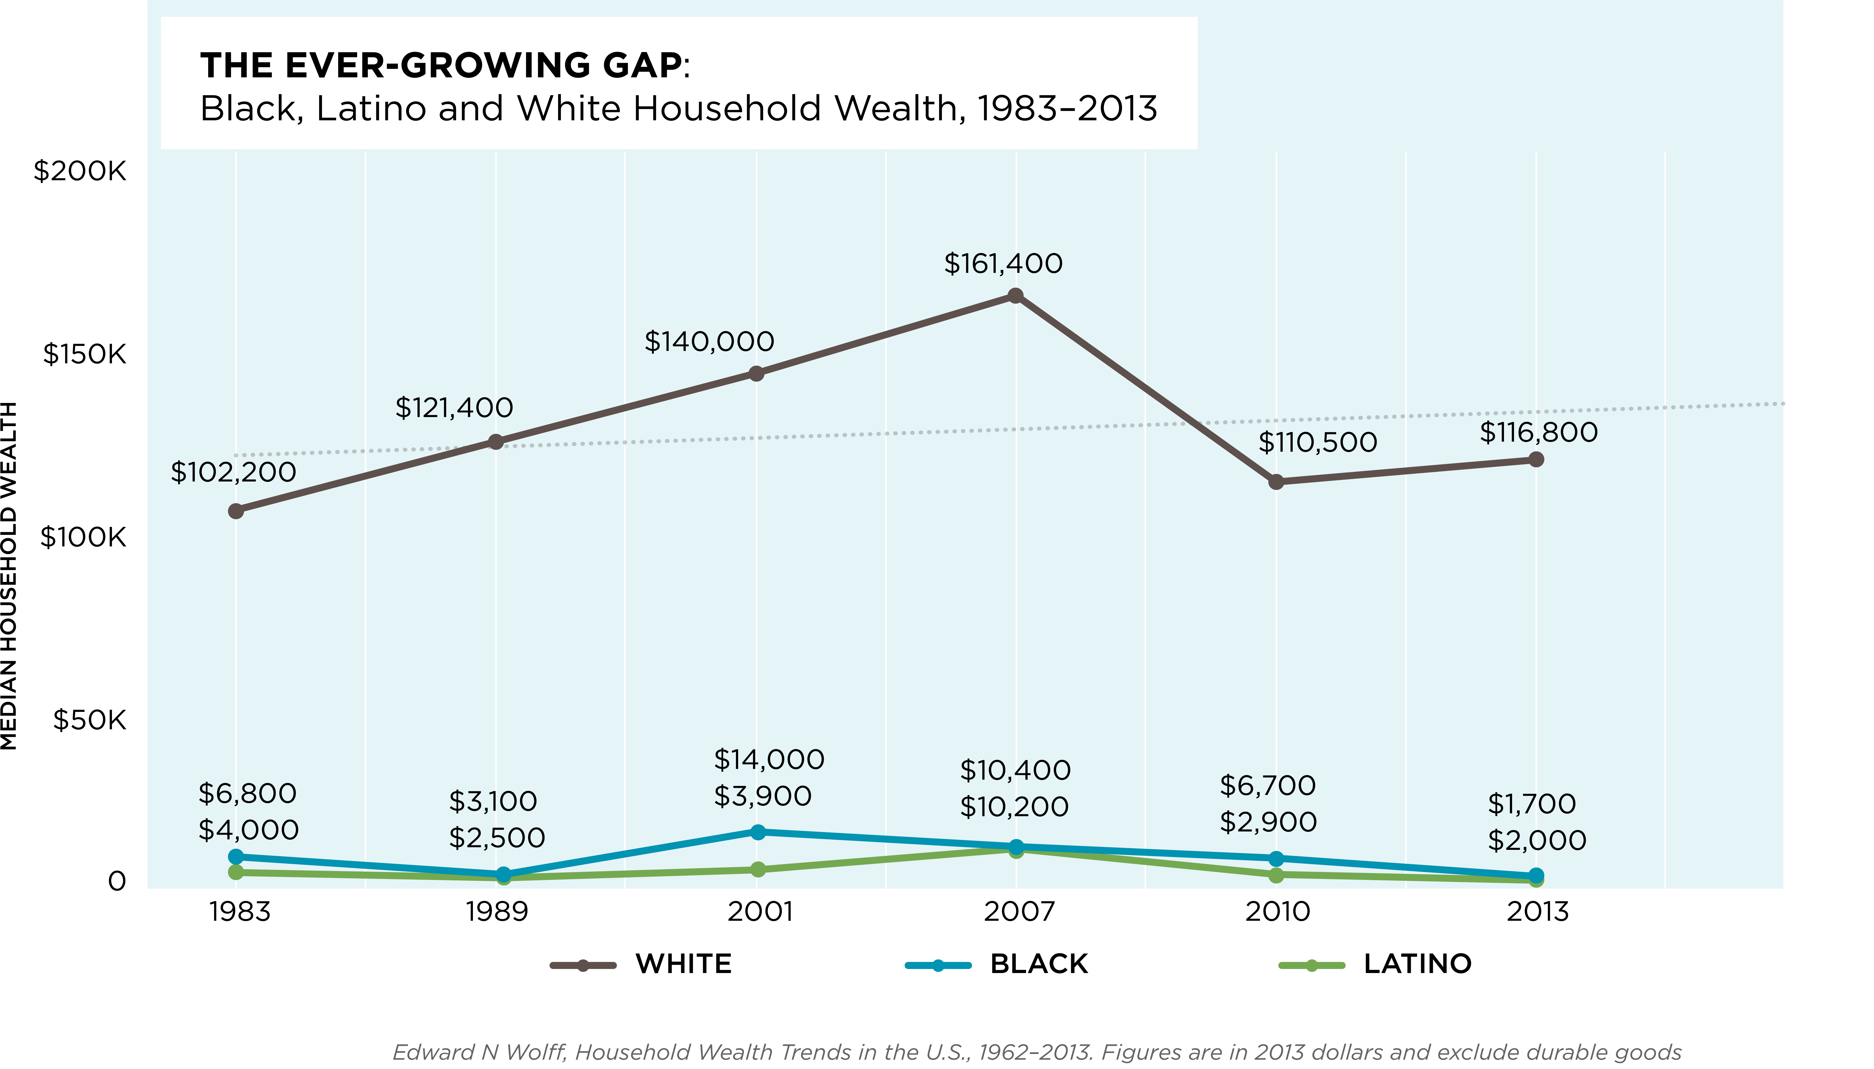
INEQUALITY IS SPLIT ALONG RACIAL LINES
2

Slide 4
BOSTON IS THE MOST UNEQUAL
MEDIAN NET WORTH:
WHITE FAMILIES
BLACK FAMILIES
$247,500
$8
Boston was named the most unequal city by income by the Brookings Institution in 2016.
Federal Reserve Bank of Boston 2016 Report
3

Slide 5
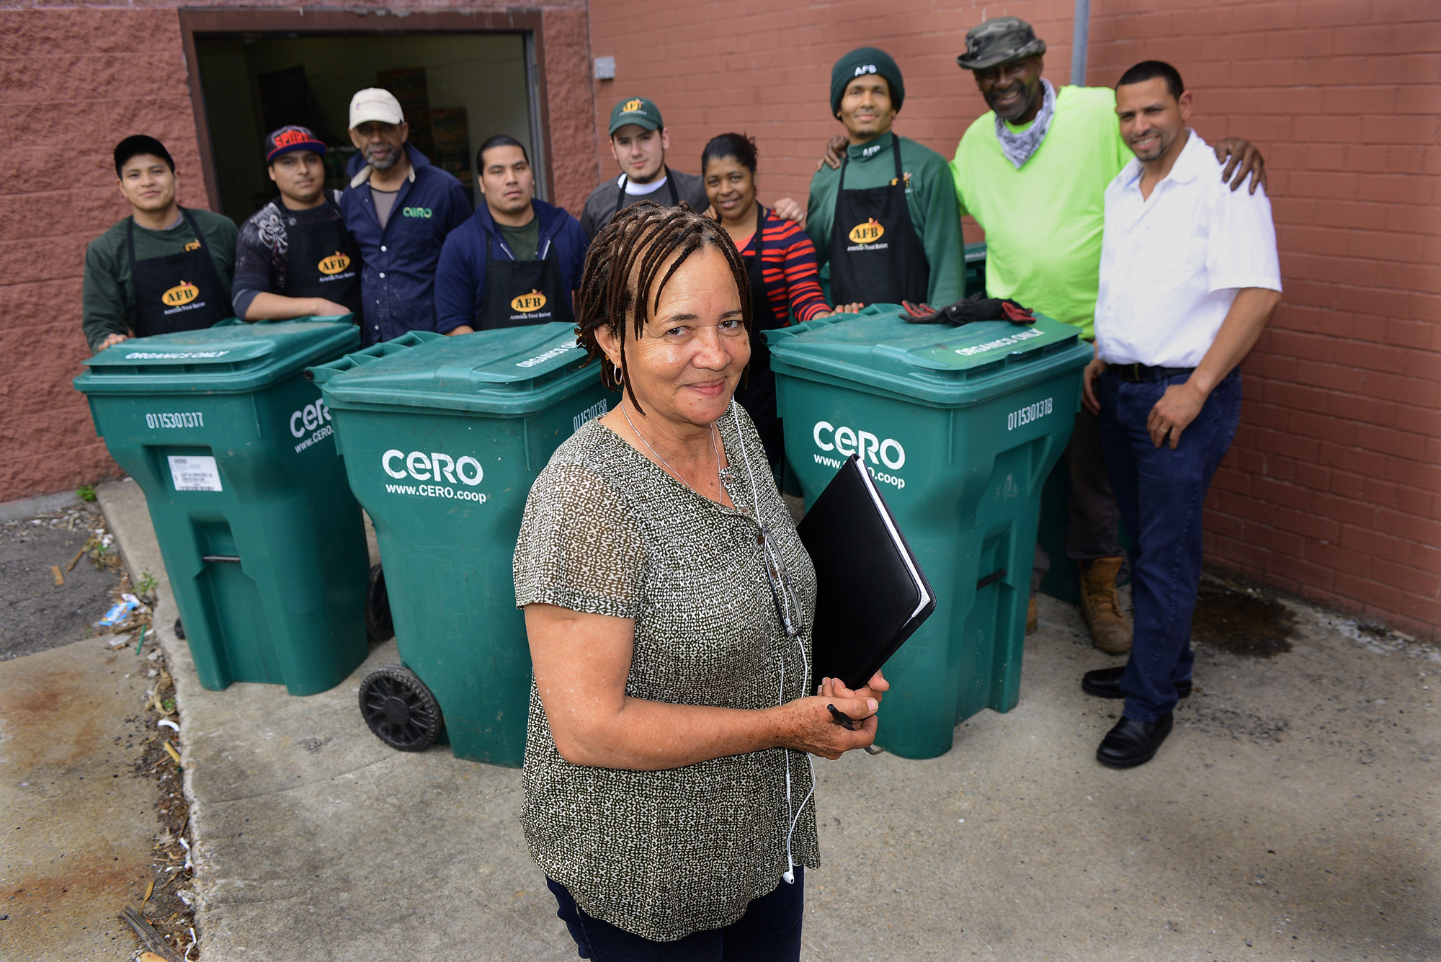
Ted Fitzgerald, Boston Herald

Slide 6
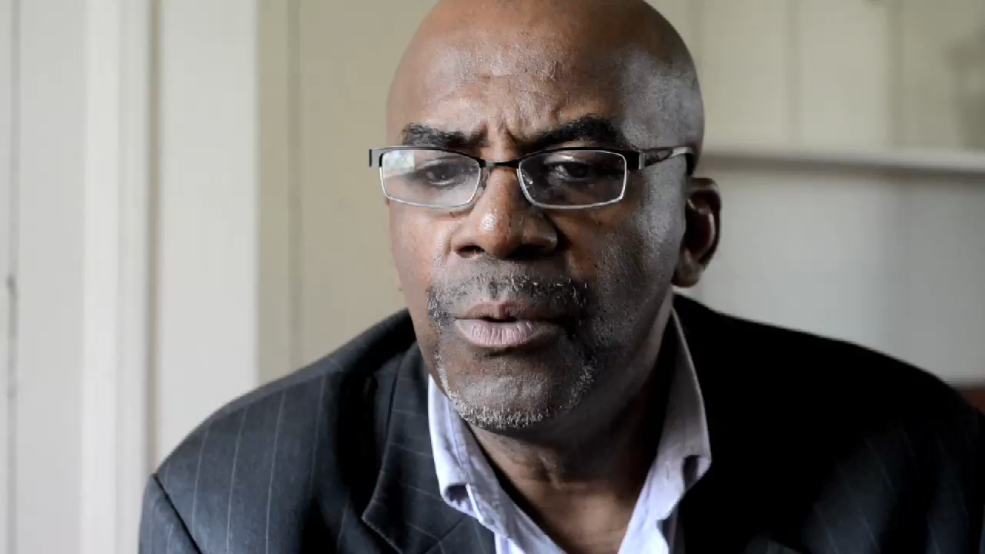

Slide 7
FINANCING CERO
INVESTMENT TERMS
$60,000 over 2 years
$20,000 at 0% interest over 3 years
$17,000 on IndieGogo
$340,000 at 4% dividend after 3 years
$150,000 secured, $175,000 unsecured at 3-5% over 7 years
2012 GRANT
2013 LOAN
2013 CROWD
2014 DPO
2016 LOAN
6

Slide 8
HOW CHANGE HAPPENS

Slide 9
HOW CHANGE HAPPENS
EMERGENCE OF THE NEW
Section in footer

Slide 10
FROM SEPARATION…
TO RELATIONSHIP
Individualism
Survival of the Fittest
Competition
Accumulation
Dominion Over Nature
Interdependence
Opportunity for All
Cooperation
Flow
Wisdom of Nature
9

Slide 11
ASK: “WHO ELSE IS HERE?”
EMERGENCE OF THE NEW
Section in footer

Slide 12
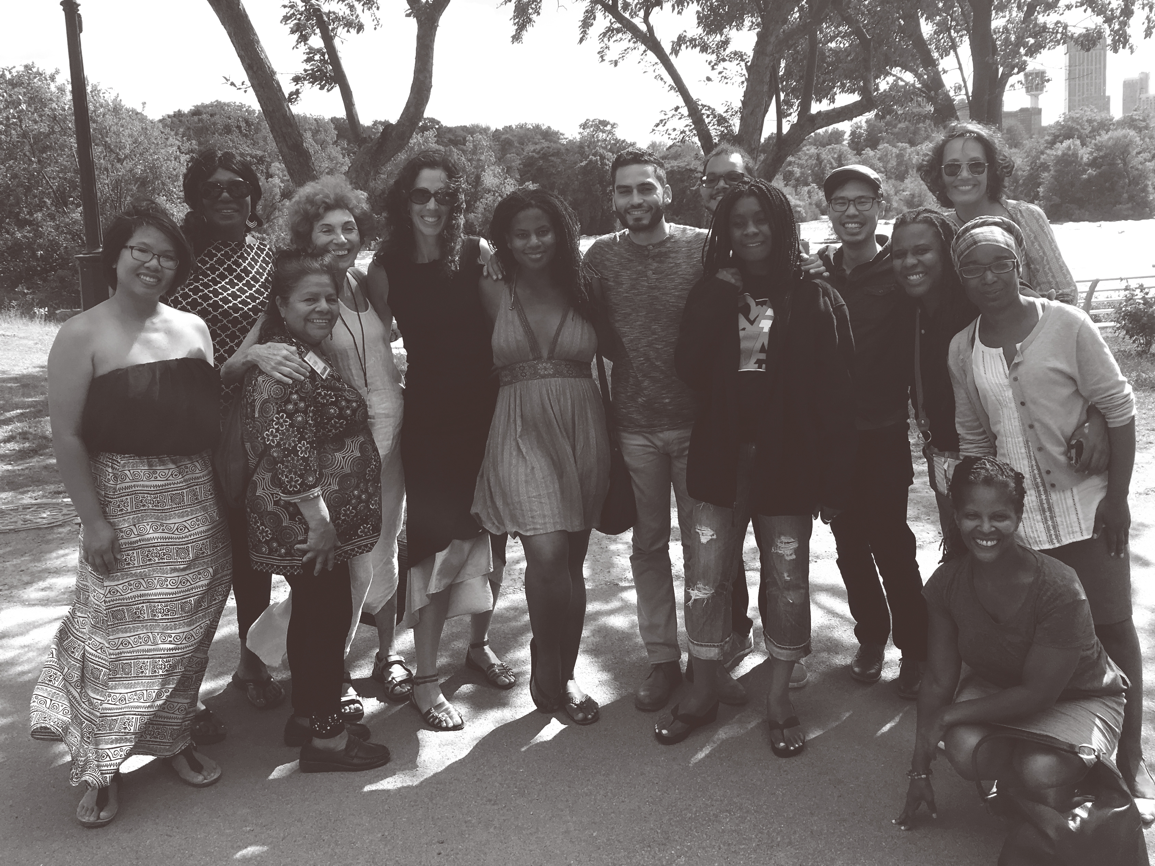
WE ARE A PLACE-BASED, IMPACT INVESTING FUND WITH A FOCUS ON ECONOMIC JUSTICE

Slide 13

REFLECTION
Where do I place myself in the ecosystem?
How tightly connected am I?
Where are there opportunities to strengthen ties?
If we want to build a strong and resilient economic system, we ask…
12

Slide 14
DEBORAH FRIEZE
deborah@bostonimpact.com
617.340.6630
www.bostonimpact.com
@bosimpact
13

Slide 15
APPENDIX

Slide 16
INVESTMENT CRITERIA
To restore productive capacity,
we need to invest in just, resilient
and healthy enterprises.
COMMUNITY RESILIENCE
Place
Nature
Relationships
ECONOMIC
JUSTICE
Ownership
Opportunity
Participation
ENTERPRISE HEALTH
Finance
Leadership
Organizations
15

